Slide 1
Machine Learning Implementations in Arabic Text Classification
Marwa F. Mohamed

Slide 2
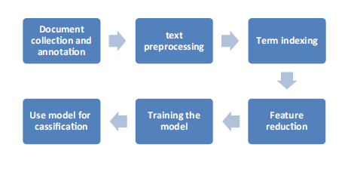
Text Classification Steps

Slide 3
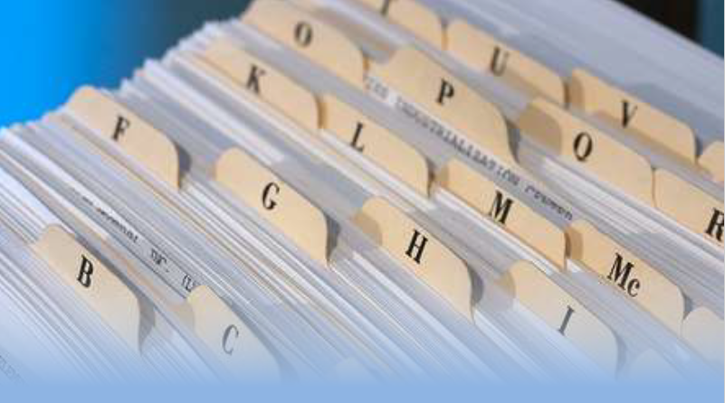
Indexing
The process of tagging or associating information with a file so it can be used for search and retrieval purposes later.
Indexing creates the “searchable” information that users will later use to find documents.

Slide 4
Document Indexing
Is the process of associating information with a file or specific tag for search and retrieval purposes in the future.
The Indexed information will then be programmed into a database / document management system, which helps users to easily access the data they require.
Without implementing a document indexing process, the ability to retrieve documents can be very time consuming and costly.
From this perspective, vector space representation can be considered a document indexing method.

Slide 5
Text Vectorization
Machine learning with natural language is faced with one major hurdle – its algorithms usually deal with numbers, and natural language is, well, text.
So we need to transform that text into numbers, otherwise known as text vectorization.
It’s a fundamental step in the process of machine learning for analyzing data, and different vectorization algorithms will drastically affect end results, so you need to choose one that will deliver the results you’re hoping for.

Slide 6
Text Vectorization
TF-IDF enables us to gives us a way to associate each word in a document with a number that represents how relevant each word is in that document.
Then, documents with similar, relevant words will have similar vectors, which is what we are looking for in a machine learning algorithm.

Slide 7
Text Vectorization
Text Vectorization refers to a set of feature extraction techniques in Natural Language Processing (NLP).
Most importantly aims at transforming words into numbers and text documents into high dimensional vector space model.
It is especially helpful in some of the most important applications of text classifiers like finding spam/not spam messages.

Slide 8
TF-IDF
TF-IDF stands for Term Frequency Inverse Document Frequency of records.
It can be defined as the calculation of how relevant a word in a series or corpus is to a text.
TF-IDF is one of the popular and most widely used term weighting technique in today’s IR system.

Slide 9
Terminology
t — term (word)
d — document (set of words)
corpus — the total document set
N — count of corpus

Slide 10
Term Frequency
This measures the frequency of a word in a document.
tf(t,d) = count of t in d / number of words in d

Slide 11
Document Frequency
This measures the importance of document in whole set of corpus.
This is very similar to TF.
The only difference is that
TF is frequency counter for a term t in document d,
where as DF is the count of occurrences of term t in the document set N.

Slide 12
Document Frequency
In other words, DF is the number of documents in which the word is present.
We consider one occurrence if the term consists in the document at least once, we do not need to know the number of times the term is present.
df(t) = occurrence of t in documents

Slide 13
Inverse Document Frequency
IDF is the inverse of the document frequency which measures the informativeness of term t.
When we calculate IDF, it will be very low for the most occurring words such as stop words.
Because stop words such as “is” is present in almost all of the documents, and N/df will give a very low value to that word.
This finally gives what we want, a relative weightage.
idf(t) = N/df

Slide 14
Inverse Document Frequency
In case of a large corpus, say 10,000, the IDF value explodes.
So to dampen the effect we take the logarithm of IDF.
idf(t) = log(N/df)

Slide 15
Inverse Document Frequency
idf(t) = log [ n / df(t) ] + 1
The effect of adding “1” to the idf in the equation above is that terms with zero idf, i.e., terms that occur in all documents in a training set, will not be entirely ignored.
Notes:
ln (x) = log e (x)

Slide 16
Inverse Document Frequency
The constant “1” is added to the numerator and denominator of the idf as if an extra document was seen containing every term in the collection exactly once, which prevents zero divisions:
idf(t) = log [ (1 + n) / (1 + df(t)) ] + 1.

Slide 17
Example: Inverse Document Frequency
Let us identify the individual values for the words — potential and wings.
Number of Documents = 8
Number of documents in the corpus that contain the word potential = 1
Number of documents in the corpus that contain the word wings = 2
Applying the formula for Inverse Document Frequency, we get

Slide 18
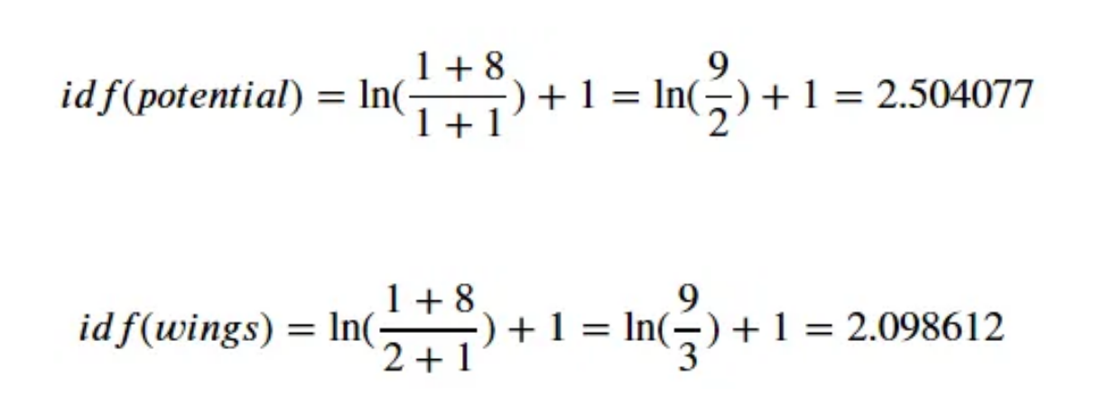
Inverse Document Frequency

Slide 19
TF-IDF
The tf-idf measure allows us to evaluate the importance of a term to a document.
The importance is proportional to the number of times the term appears in the document (TF) but is offset by the frequency of the documents in which the term has occurred (IDF).

Slide 20
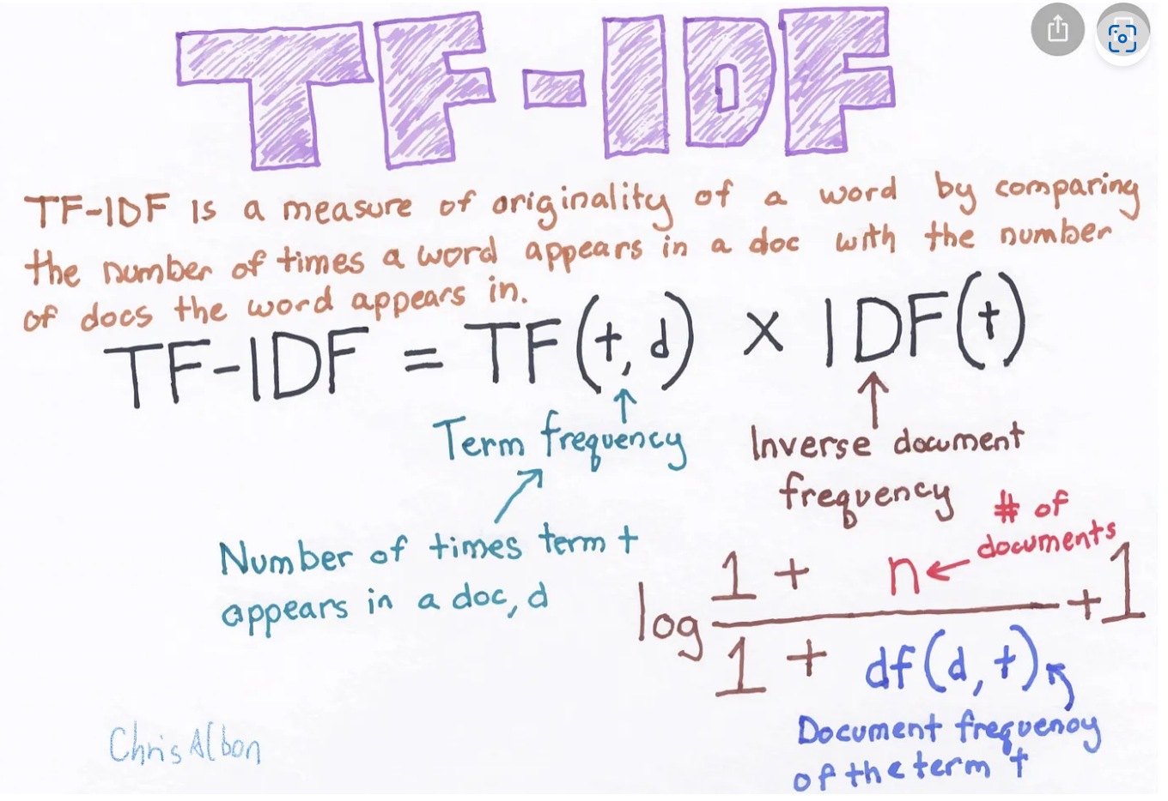

Slide 21
TF-IDF
Tf-idf is one of the best metrics to determine how significant a term is to a text in a series or a corpus.
Tf-idf is a weighting system that assigns a weight to each word in a document based on its term frequency (tf) and the reciprocal document frequency (tf) (idf).
The words with higher scores of weight are deemed to be more significant.
In python tf-idf values can be computed using TfidfVectorizer() method in sklearn module.

Slide 22
Example 1
# assign documents
d1 = 'Geeks for geeks’
d2 = 'Geeks’
d3 = 'r2j'

Slide 23
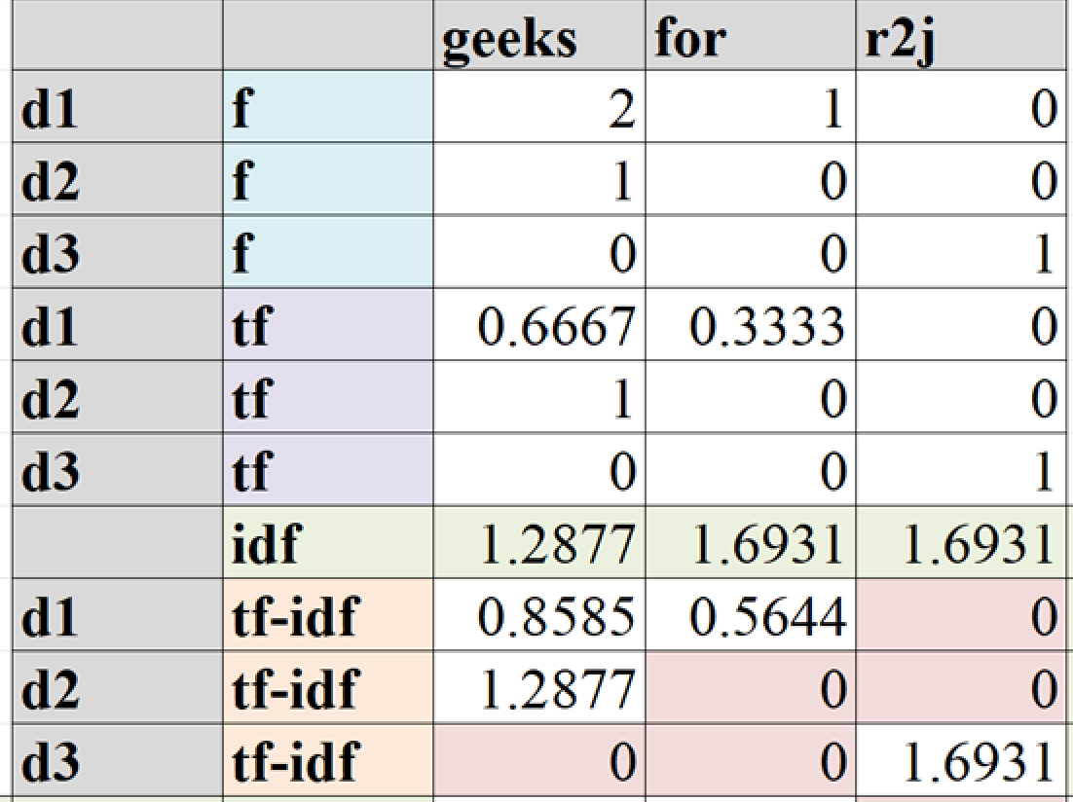

Slide 24
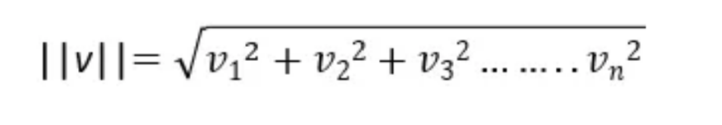
Normalize the product of TF and IDF
To apply L2 norm, for each of the sentences we need to calculate the square root of the sum of squares of the product of TF and IDF.

Slide 25
Normalize the product of TF and IDF
Sum of square for d1 =SQRT(0.8585²+0.5644²) = 1.027361662
TF-IDF (geeks) = 0.8585 / 1.027361662 = 0.8355915
TF-IDF (for) = 0.5644 / 1.027361662 = 0.5493512

Slide 26
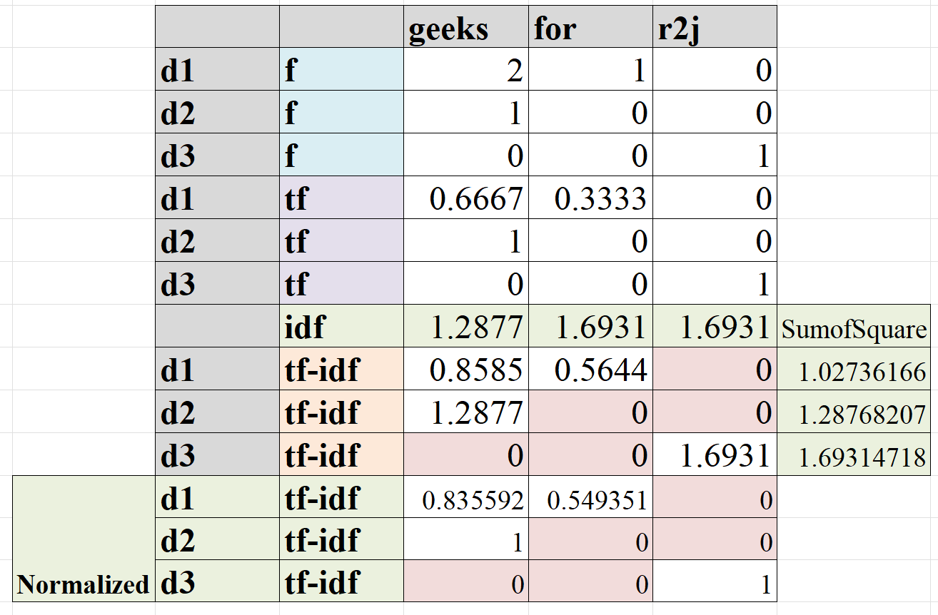

Slide 27
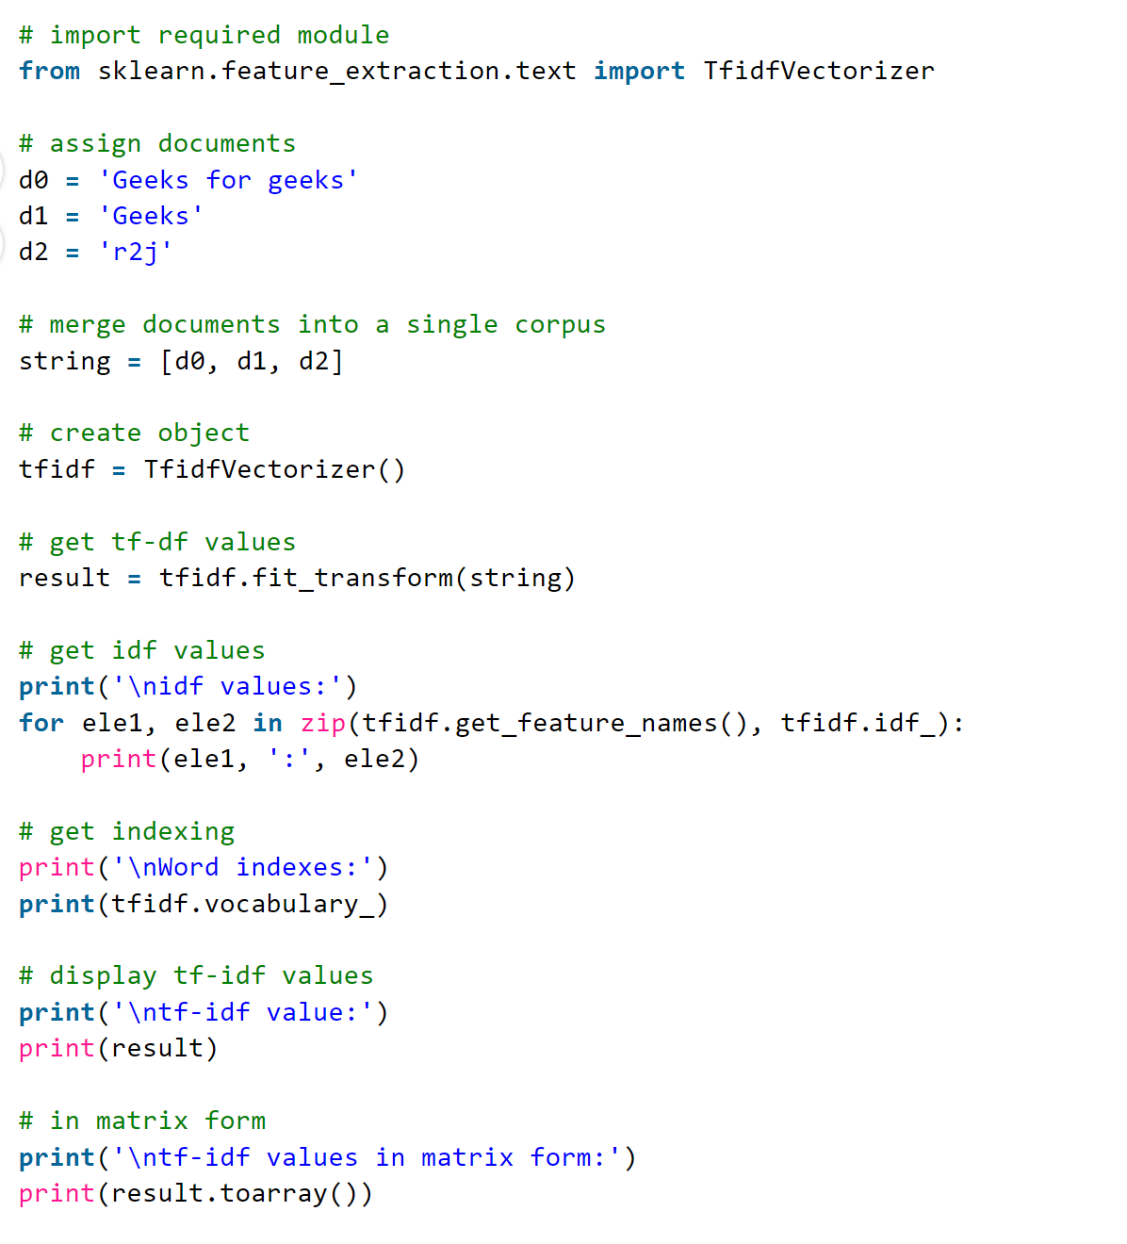

Slide 28
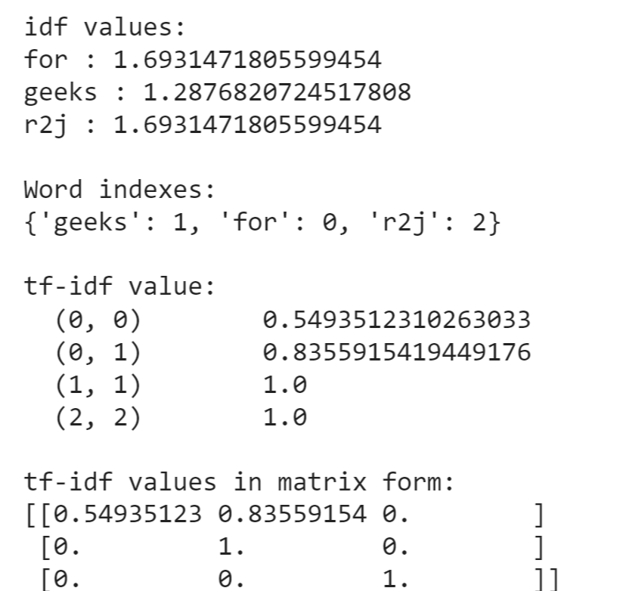

Slide 29
Example 2
tf-idf values are computed from a corpus having unique values.
# assign documents
d0 = 'geek1'
d1 = 'geek2'
d2 = 'geek3'
d3 = 'geek4'

Slide 30
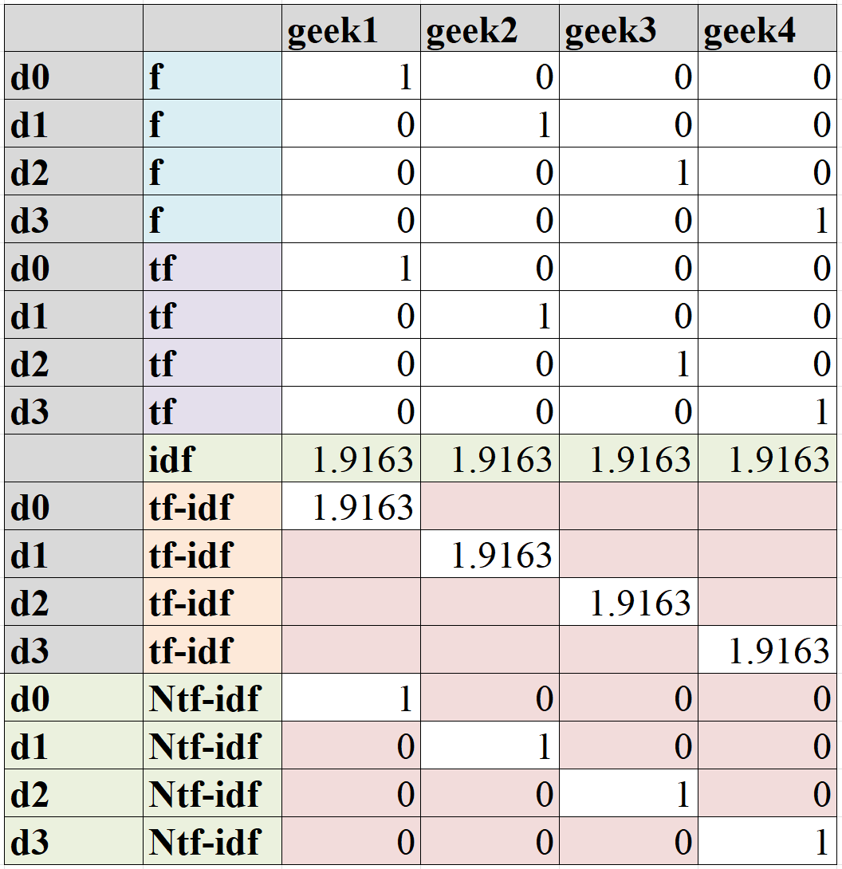

Slide 31
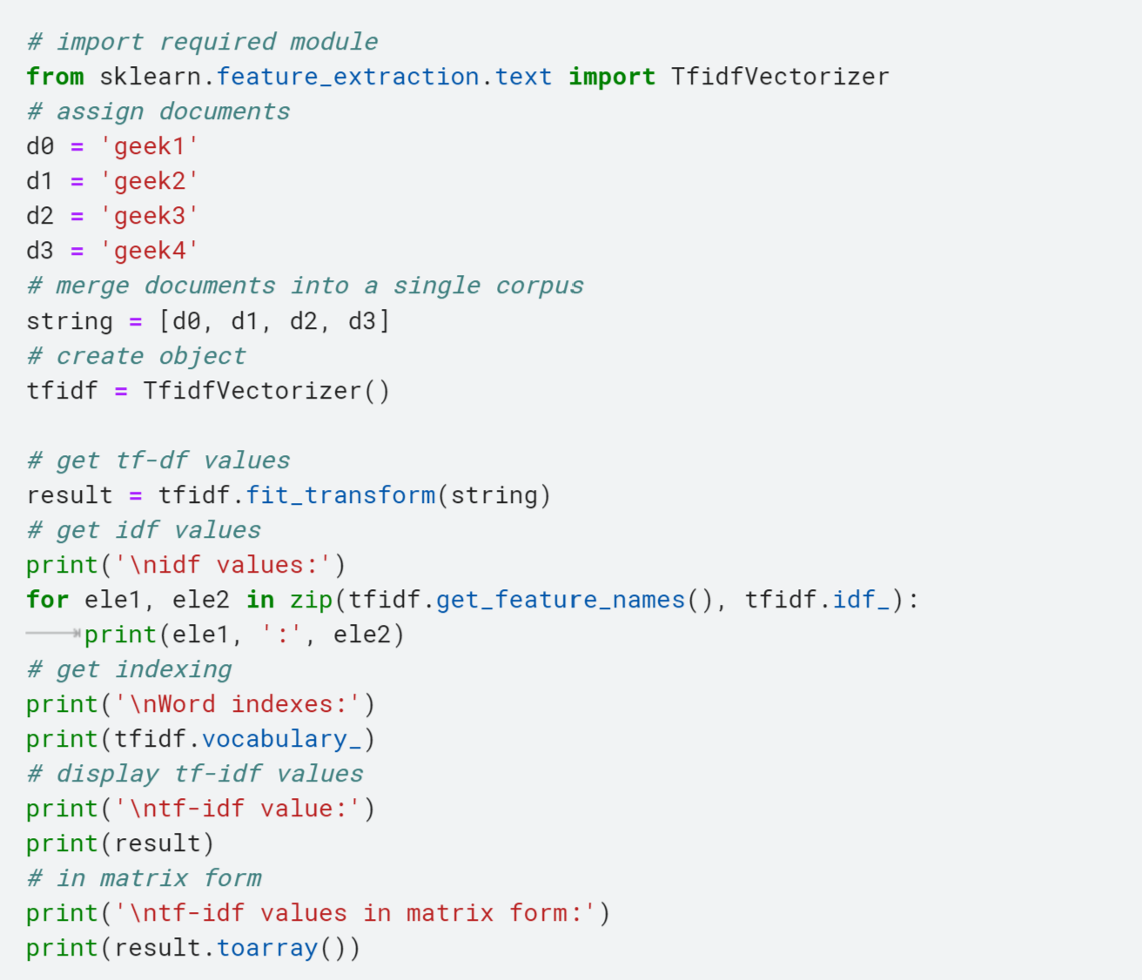

Slide 32
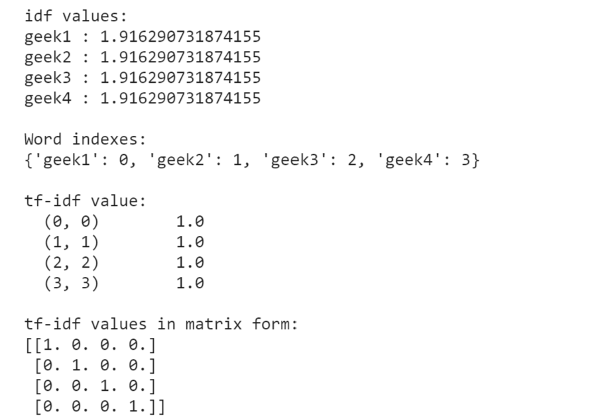

Slide 33
Example 3
tf-idf values are computed from a corpus having similar documents.
# assign documents
d0 = 'Geeks for geeks!'
d1 = 'Geeks for geeks!'
Notes:
# merge documents into a single corpus
string = [d0, d1]

Slide 34
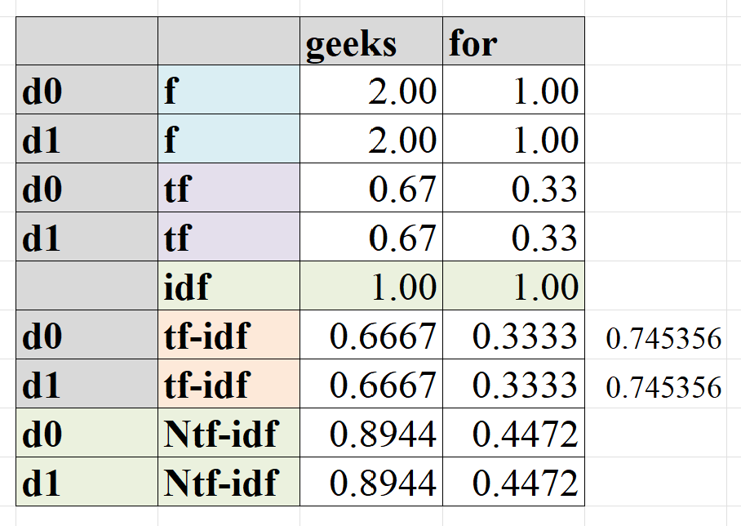
Notes:
Ln(

Slide 35
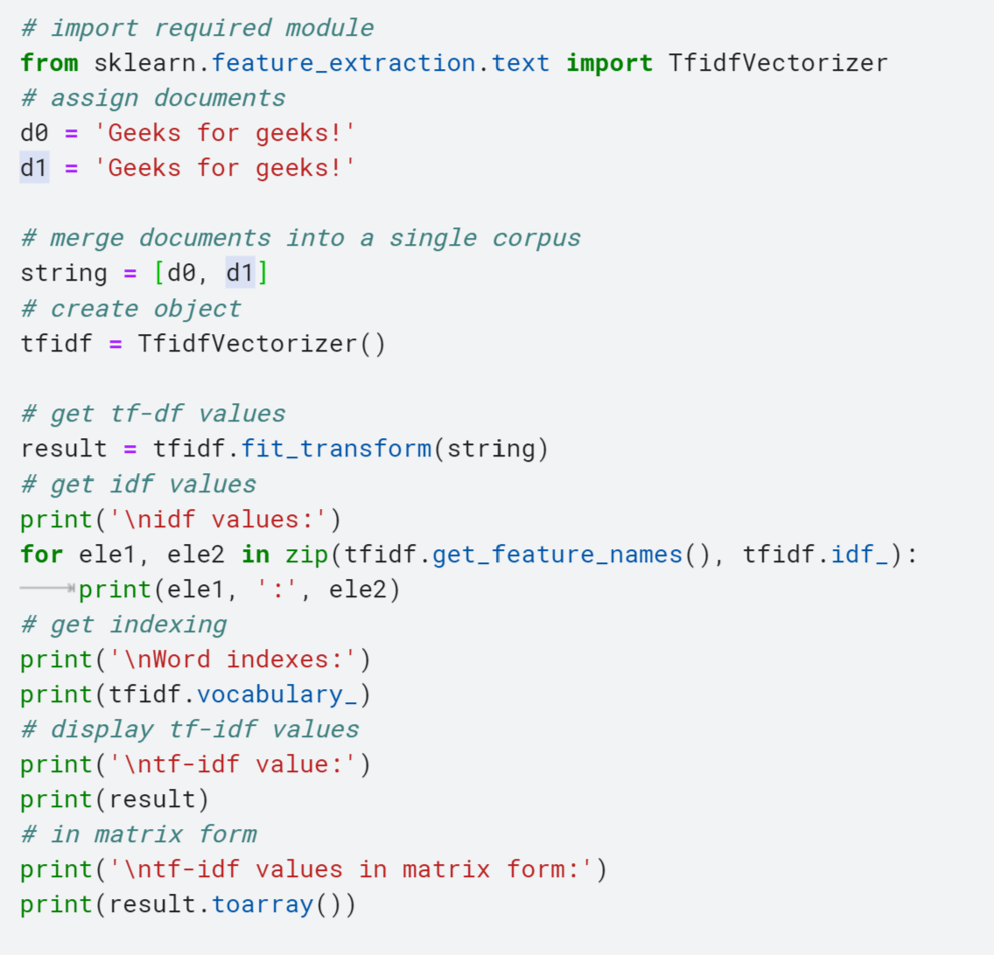

Slide 36
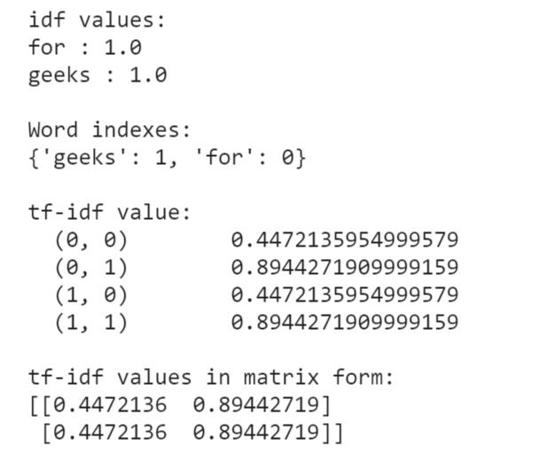

Slide 37
Applications of TF-IDF
Information retrieval
TF-IDF was invented for document search and can be used to deliver results that are most relevant to what you’re searching for.
Imagine you have a search engine and somebody looks for LeBron.
The results will be displayed in order of relevance. That’s to say the most relevant sports articles will be ranked higher because TF-IDF gives the word LeBron a higher score.
It’s likely that every search engine you have ever encountered uses TF-IDF scores in its algorithm.

Slide 38
References
Understanding TF-IDF (Term Frequency-Inverse Document Frequency) – GeeksforGeeks
Understanding TF-ID: A Simple Introduction (monkeylearn.com)
sklearn.feature_extraction.text.TfidfTransformer — scikit-learn 1.2.2 documentation
A Gentle Introduction To Calculating The TF-IDF Values | by Ann Sebastian | Towards Data Science
Notes:
Understanding TF-IDF (Term Frequency-Inverse Document Frequency) - GeeksforGeeks

